Slide 1
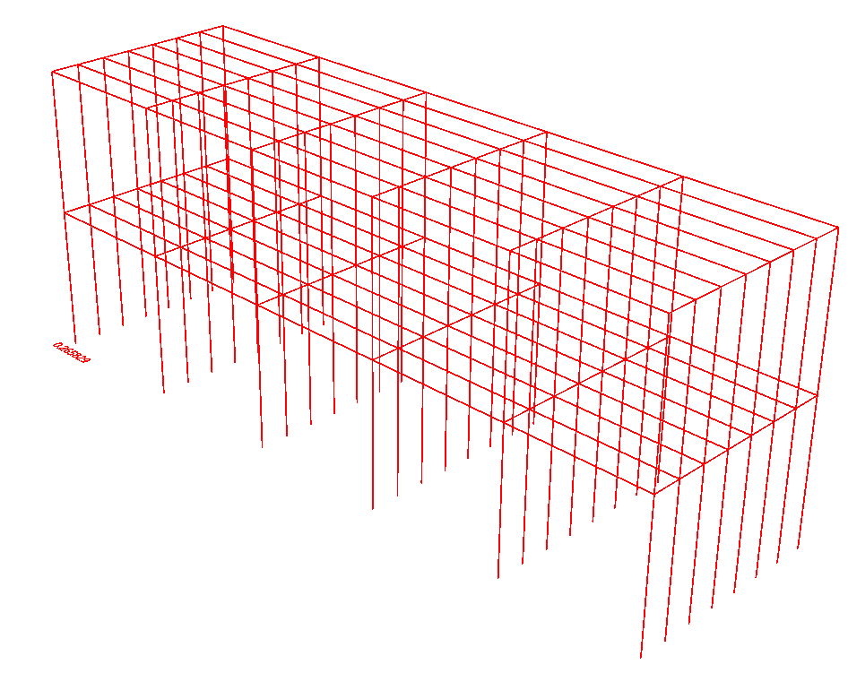
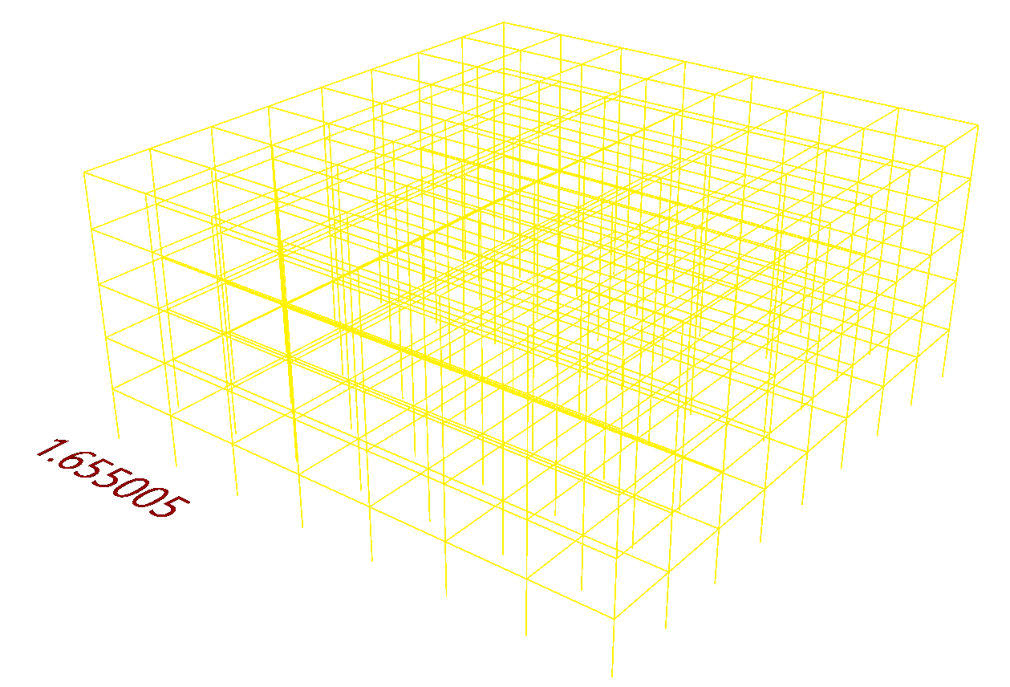
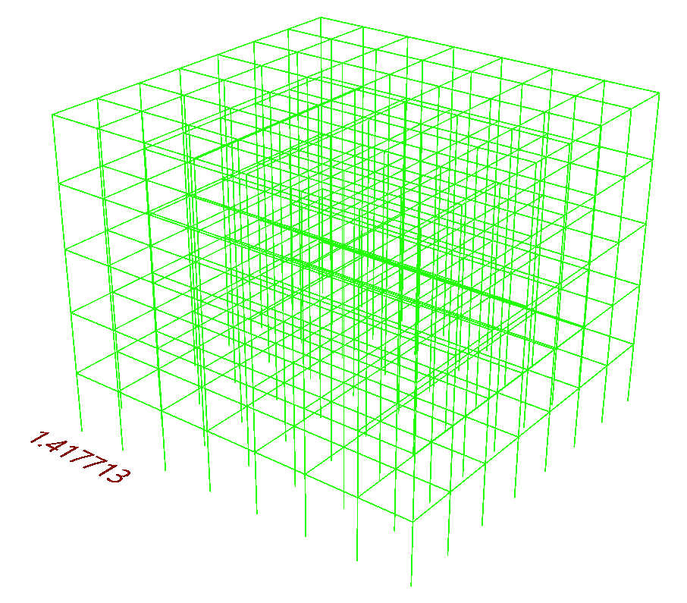
Bayesian Machine Learning for Quantifying Uncertainty in Surrogate Modelling
Archie Luxton
14th September 2022 09:00

Slide 2

Background : Project Aims
A nice picture?
Typically Finite Element (FE) models
Ensures a structure will be safe
Predicts the response to earthquakes, wind loading…
Acts as a record of design
E.g. Oasys GSA

Slide 3
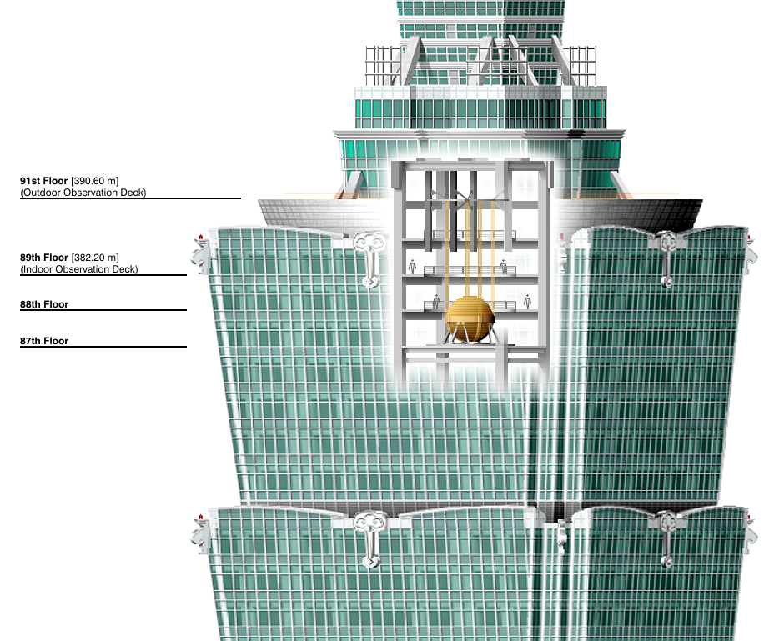
Background : Project Objective
Develop uncertainty-aware Neural Network-based surrogate models that can predict the modal frequencies of 3D structures and communicate the uncertainty in those predictions.

Slide 4


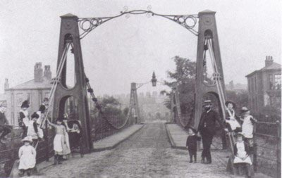
Background : Modal Analysis
Modal analysis predicts the resonant frequencies of structures
Modal frequencies of a structure shouldn't match frequency of:
Earthquakes
Footsteps and sway
Wind flutter
Mexico City earthquake, 1985
Millennium Bridge, London
Broughton Bridge collapse, 1826

Slide 5
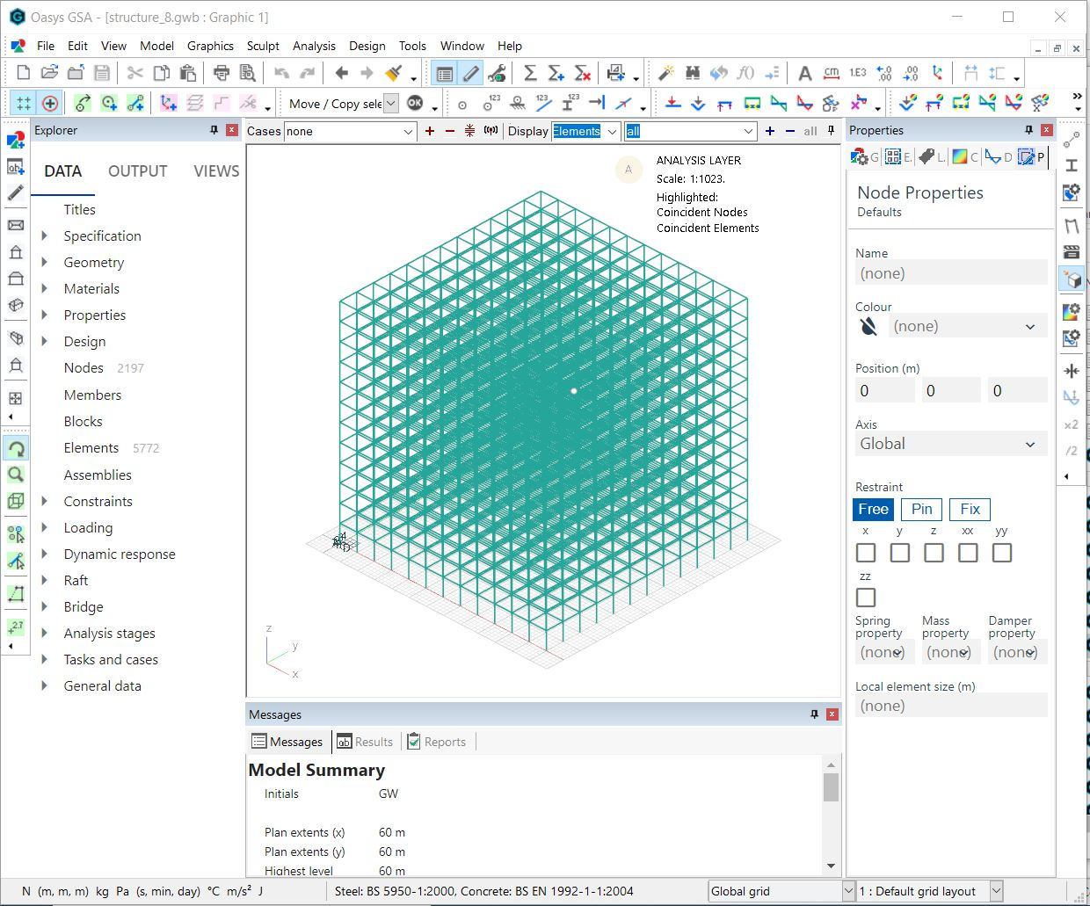
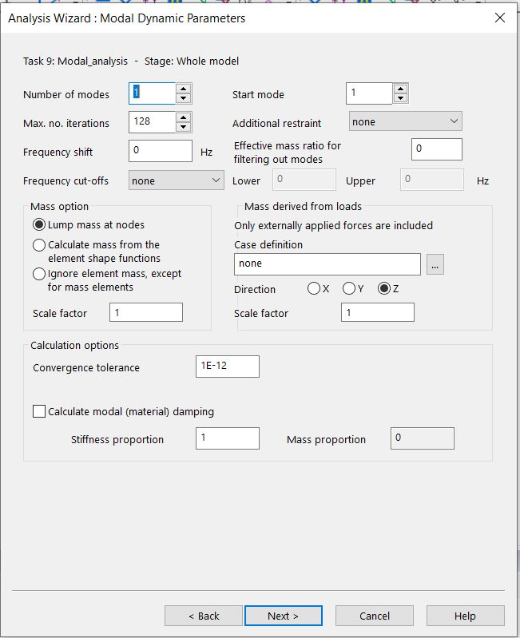

Background : Modal Analysis Using GSA
Oasys GSA can perform modal analysis
Calculates many modal frequencies of a structure
Solves a generalised eigenvalue problem
Define geometry
Define simulation parameters
Wait between 3s – 18mins

Slide 6
Background : Advantages / Disadvantages of GSA Analysis
GSA Modal Analysis
Accurate
Explainable
Expensive
Complexity scales with size of structure
Platform-specific
Automation requires APIs/SDKs
Specific to one problem

Slide 7
Background : Neural Network Surrogate Models
Trained on FE simulation results
Approximates full FE simulations
Faster inference
Not specific to one problem

Slide 8
Background : Surrogate vs GSA Analysis
GSA Modal Analysis | Modal Analysis via NN-based surrogate
Accurate | Is an approximation
Explainable | Hard to explain
Expensive | Cheap predictions
Complexity scales with size of structure | Complexity constant w.r.t. size of structure
Platform-specific | Platform agnostic / portable
Automation requires APIs/SDKs | Automation very straightforward
Specific to one problem | Applicable to many problems

Slide 9
Methodology : Overview
Research types of Uncertainty Quantification (UQ)
Implement and compare UQ methods on simple NNs
Train uncertainty-aware, NN-based surrogates
Analyse uncertainty
In domain vs. OOD
Re-training
Visualisation & communication

Slide 10
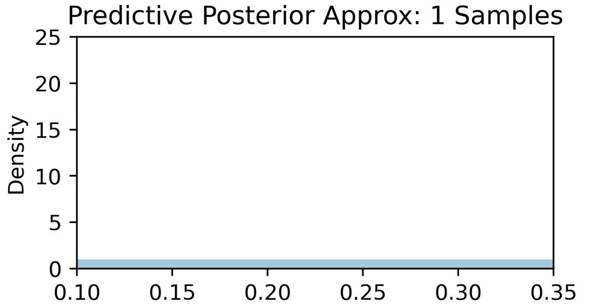
Methodology : Methods to Add Uncertainty Quantification to NNs
Two stochastic methods investigated:
MC Dropout (Gal and Ghahramani, 2016)
Stochastic Gradient Langevin Dynamics (SGLD) (Welling et al., 2011)
Both methods apply stochasticity. Sampling stochastic outputs => approximation to predictive posterior distribution

Slide 11
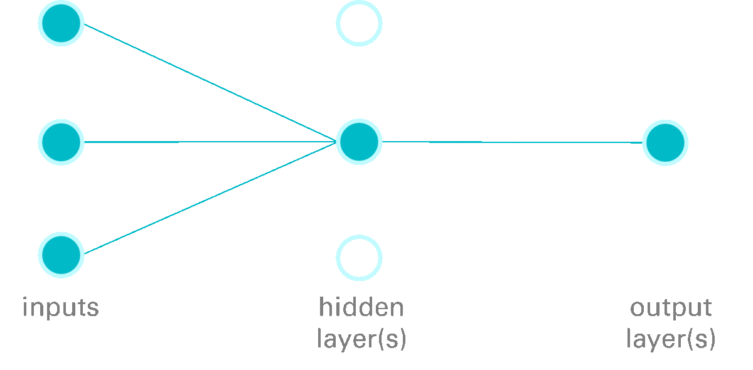
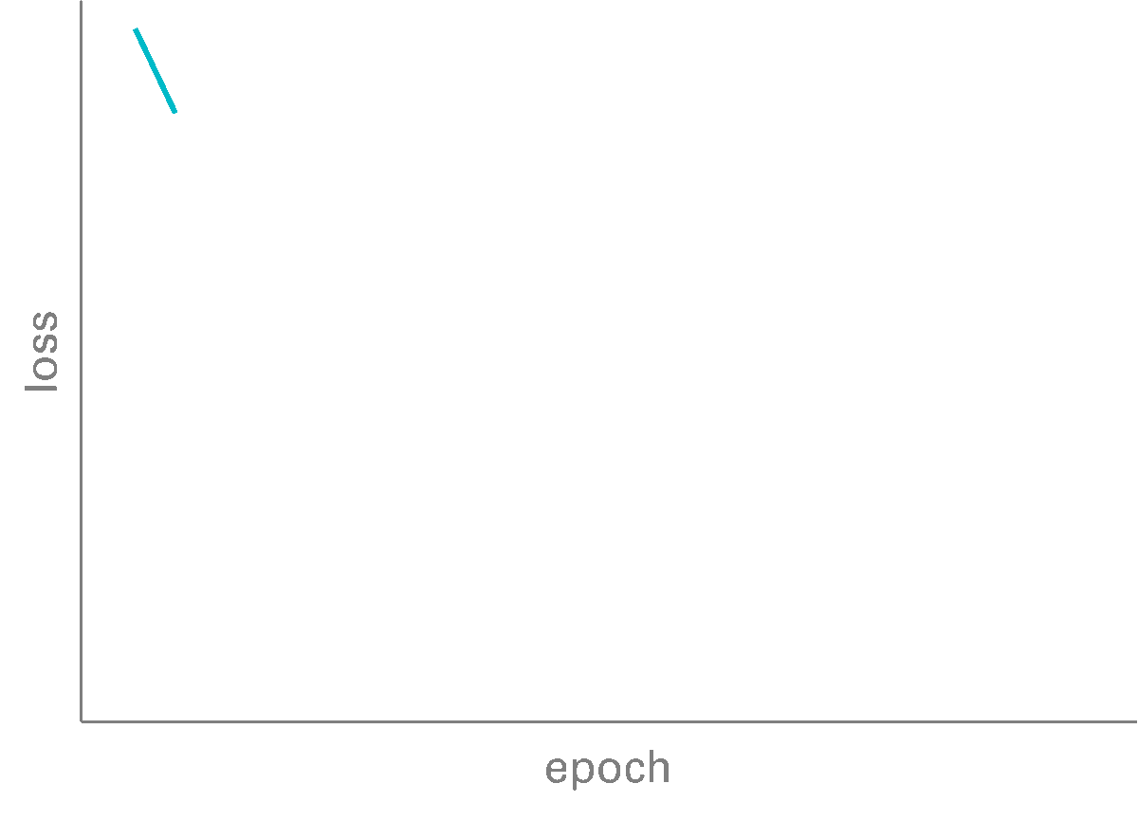
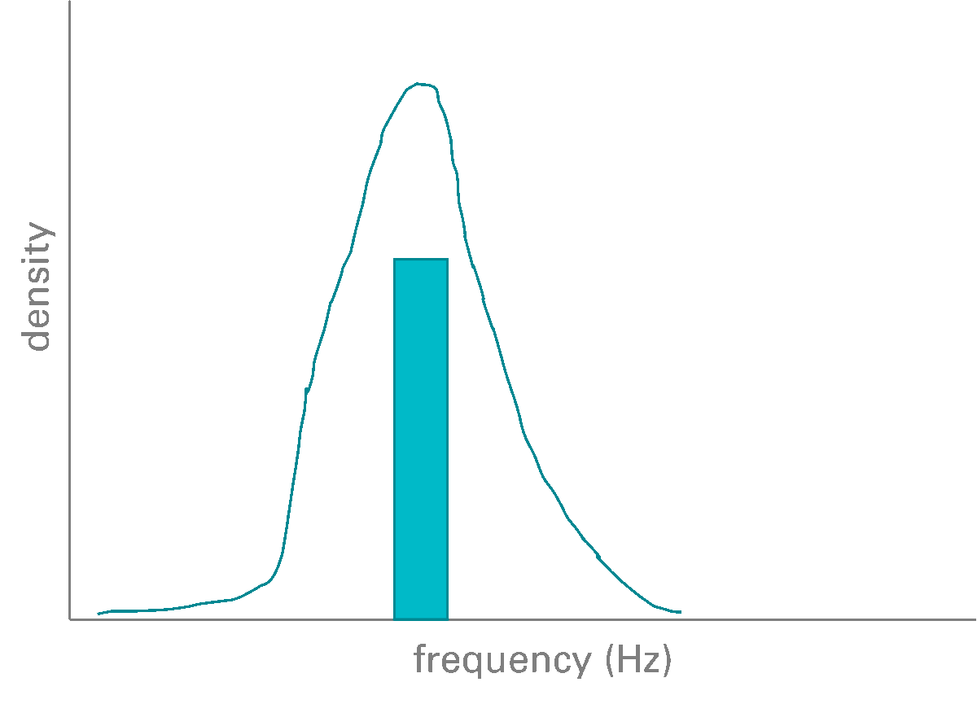
Methodology : MC Dropout
TRAINING
Learning weights + stochastic dropout
INFERENCE
Using learned weights + stochastic dropout
inputs
hidden layer(s)
output layer(s)
approximation to predictive posterior
loss
epoch

Slide 12

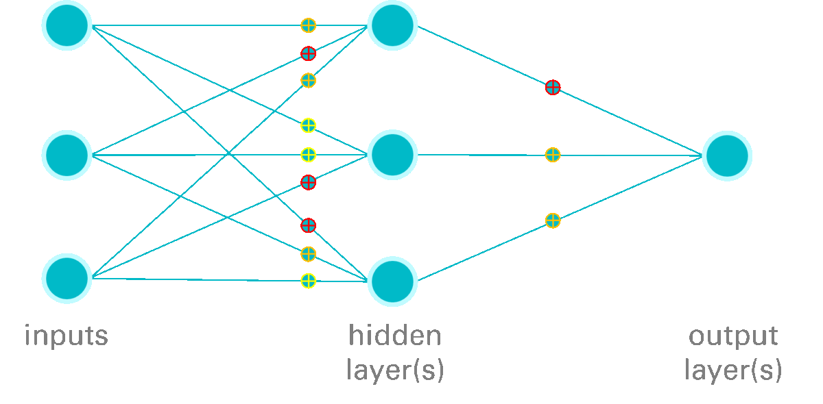
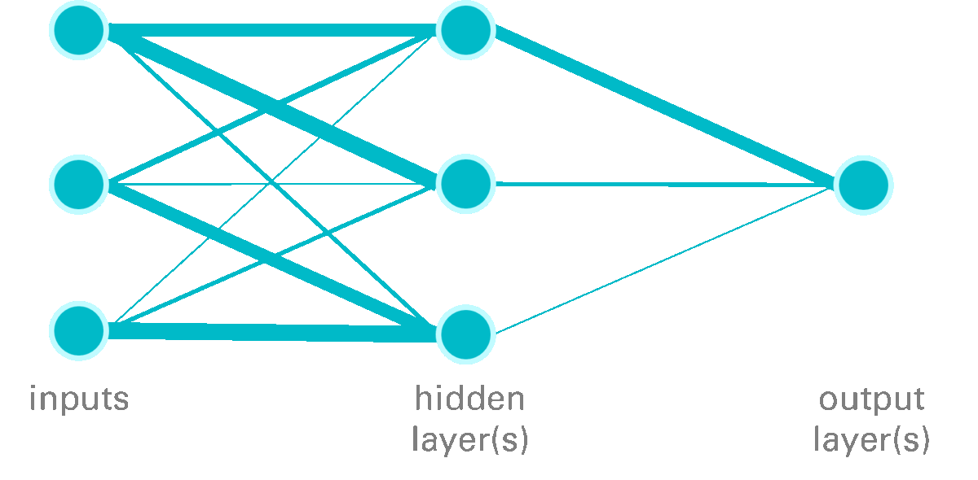

Methodology : Stochastic Gradient Langevin Dynamics (SGLD)
TRAINING
INFERENCE
Gaussian noise
η ~ N(0, lr)
inputs
hidden layer(s)
output layer(s)
inputs
hidden layer(s)
output layer(s)
burn-in
period
approximation to predictive posterior
loss
density
save model weights at checkpoints
epoch
frequency (Hz)

Slide 13
Results : Comparison of Models
 |  | MC Dropout | SGLD
Training time |  | 71s | 230s
Average RMSE: | Training | 0.007 | 0.000
 | Validation | 0.008 | 0.005
 | Test | 2.034 | 1.983
Average CI Width (+/- 1σ) | Training | 0.055 | 0.033
 | Validation | 0.057 | 0.035
 | Test | 0.273 | 0.175

Slide 14
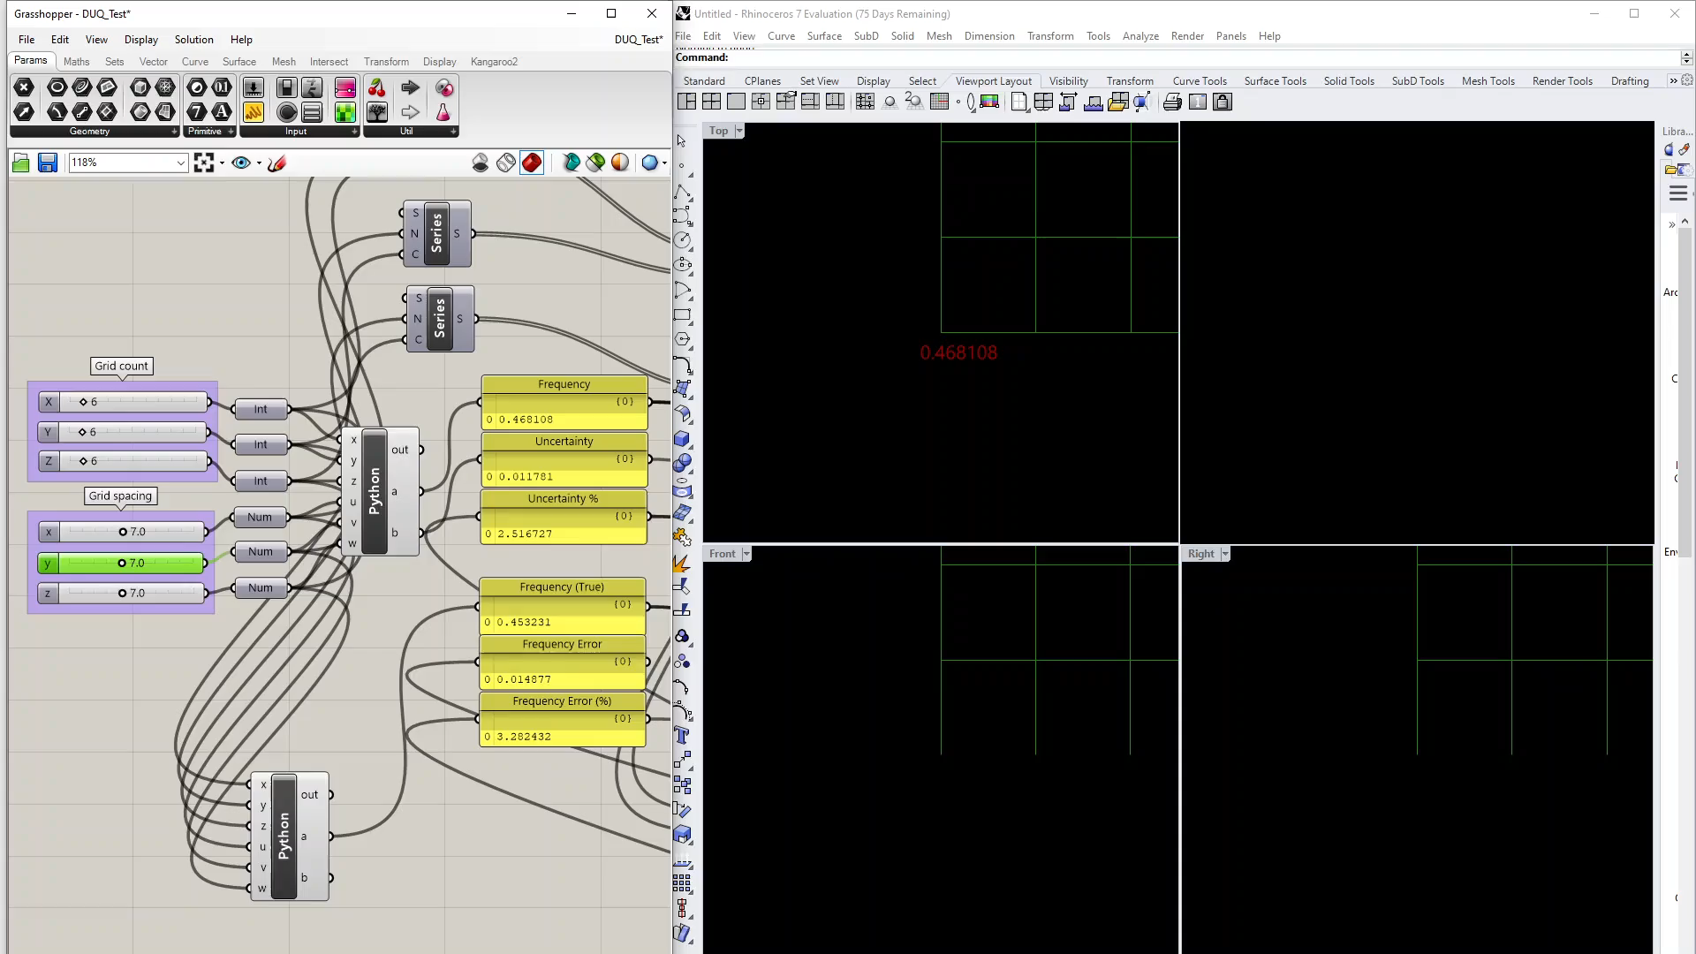
Results : Surrogate Model Demo – GH/Rhino with RESTful API

Slide 15
Results : Speed
22x22x22:
11,000x speedup
5x5x5:
500x speedup
30x30x30:
28,000x speedup

Slide 16
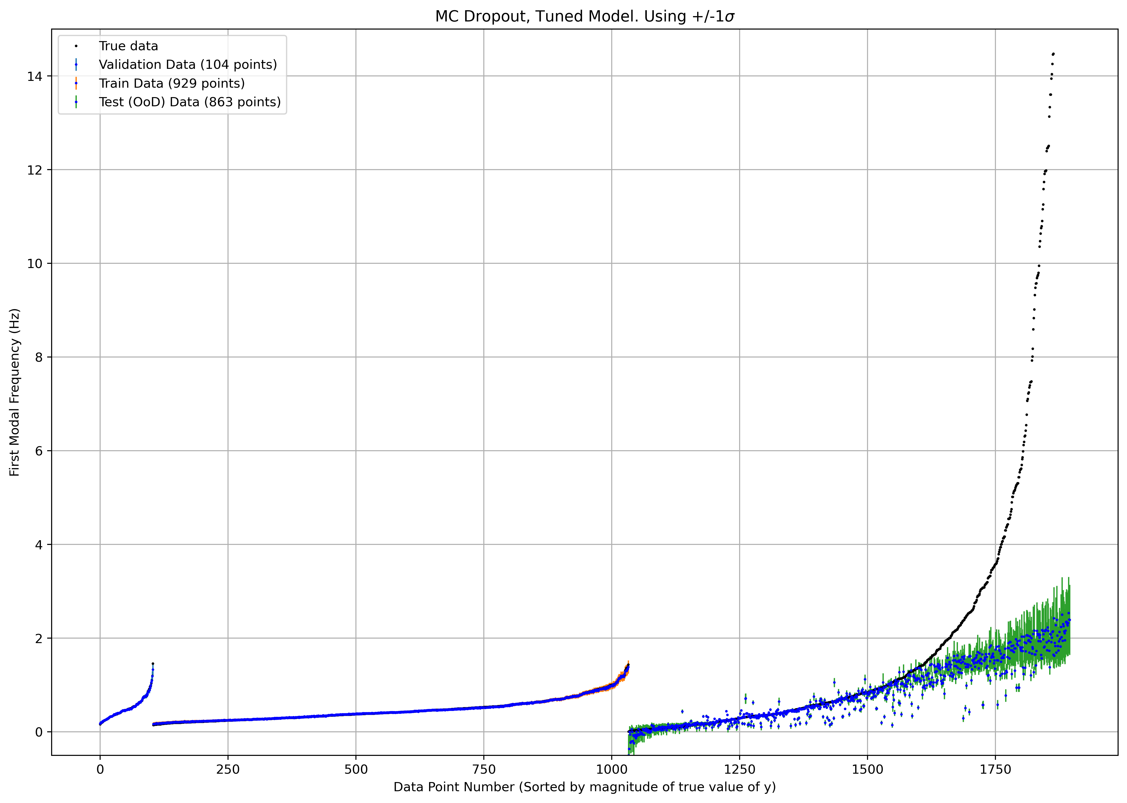
Results : Accuracy and Uncertainty: Reference Datasets

Slide 17
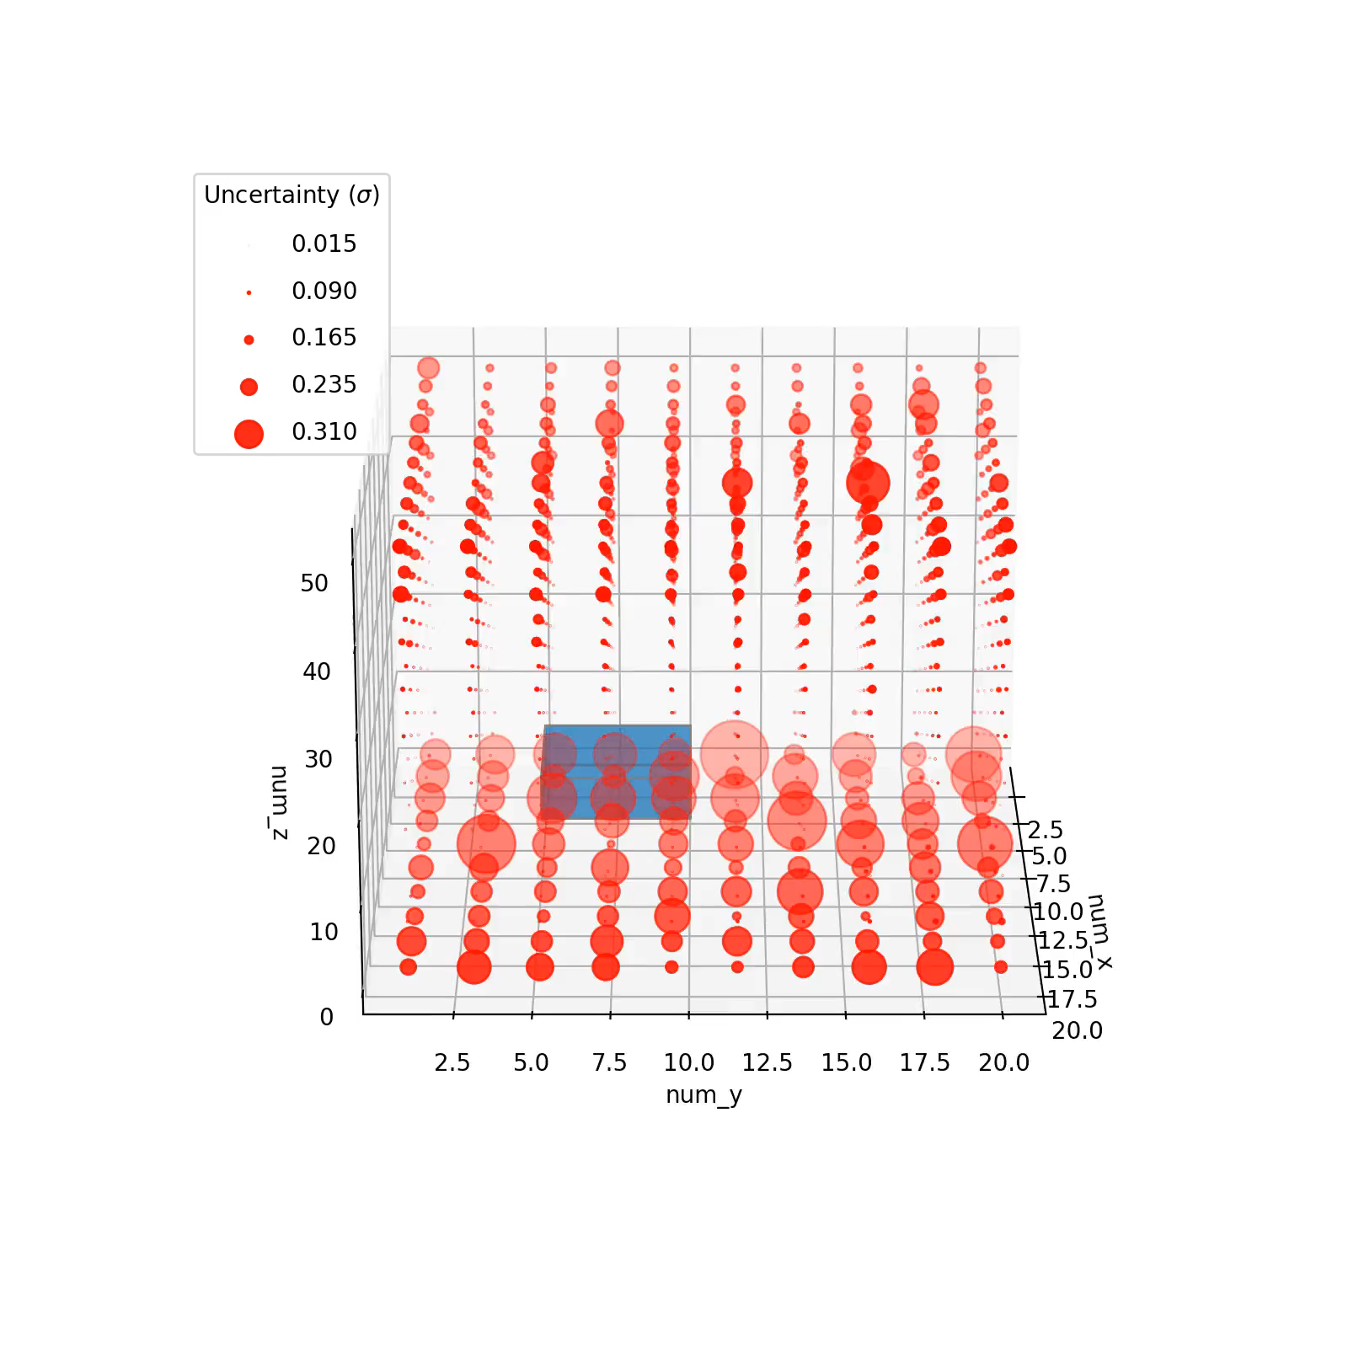
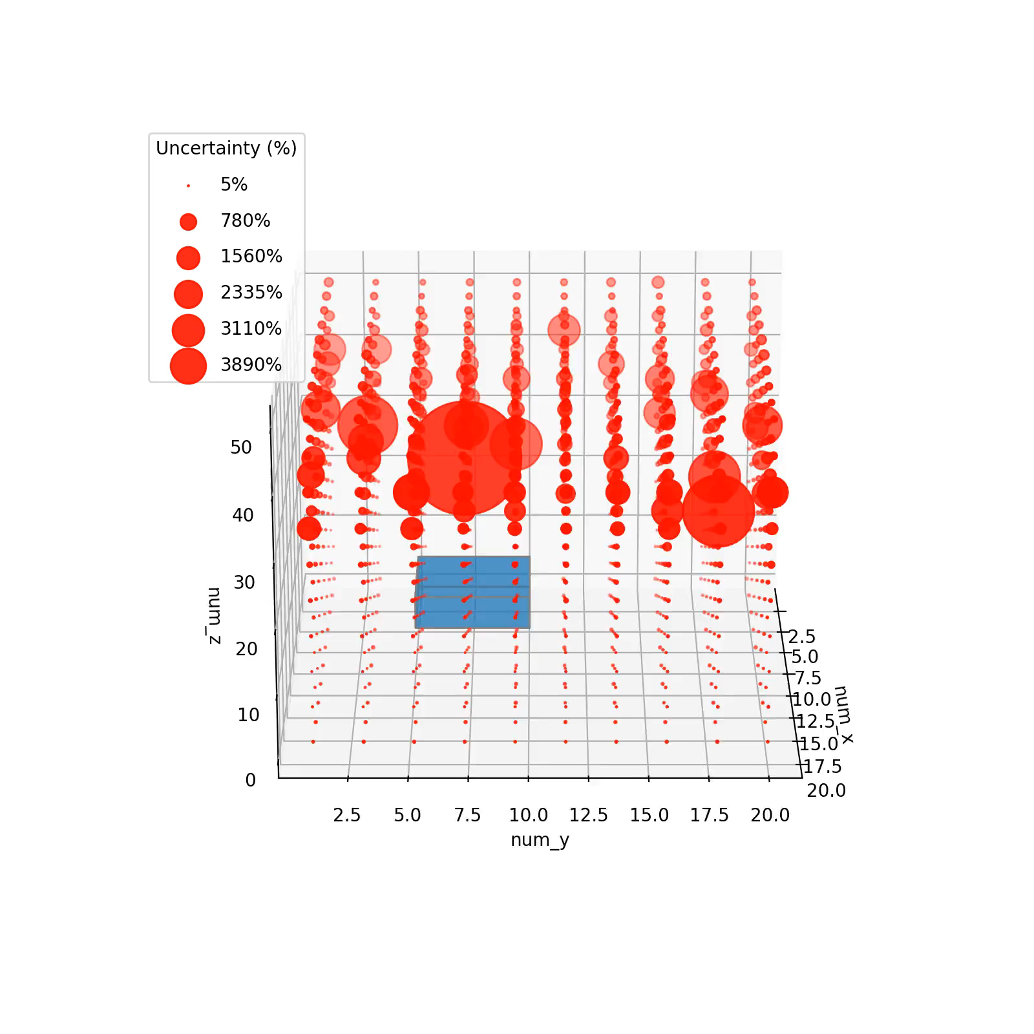
Results : Uncertainty - Unseen Geometries

Slide 18
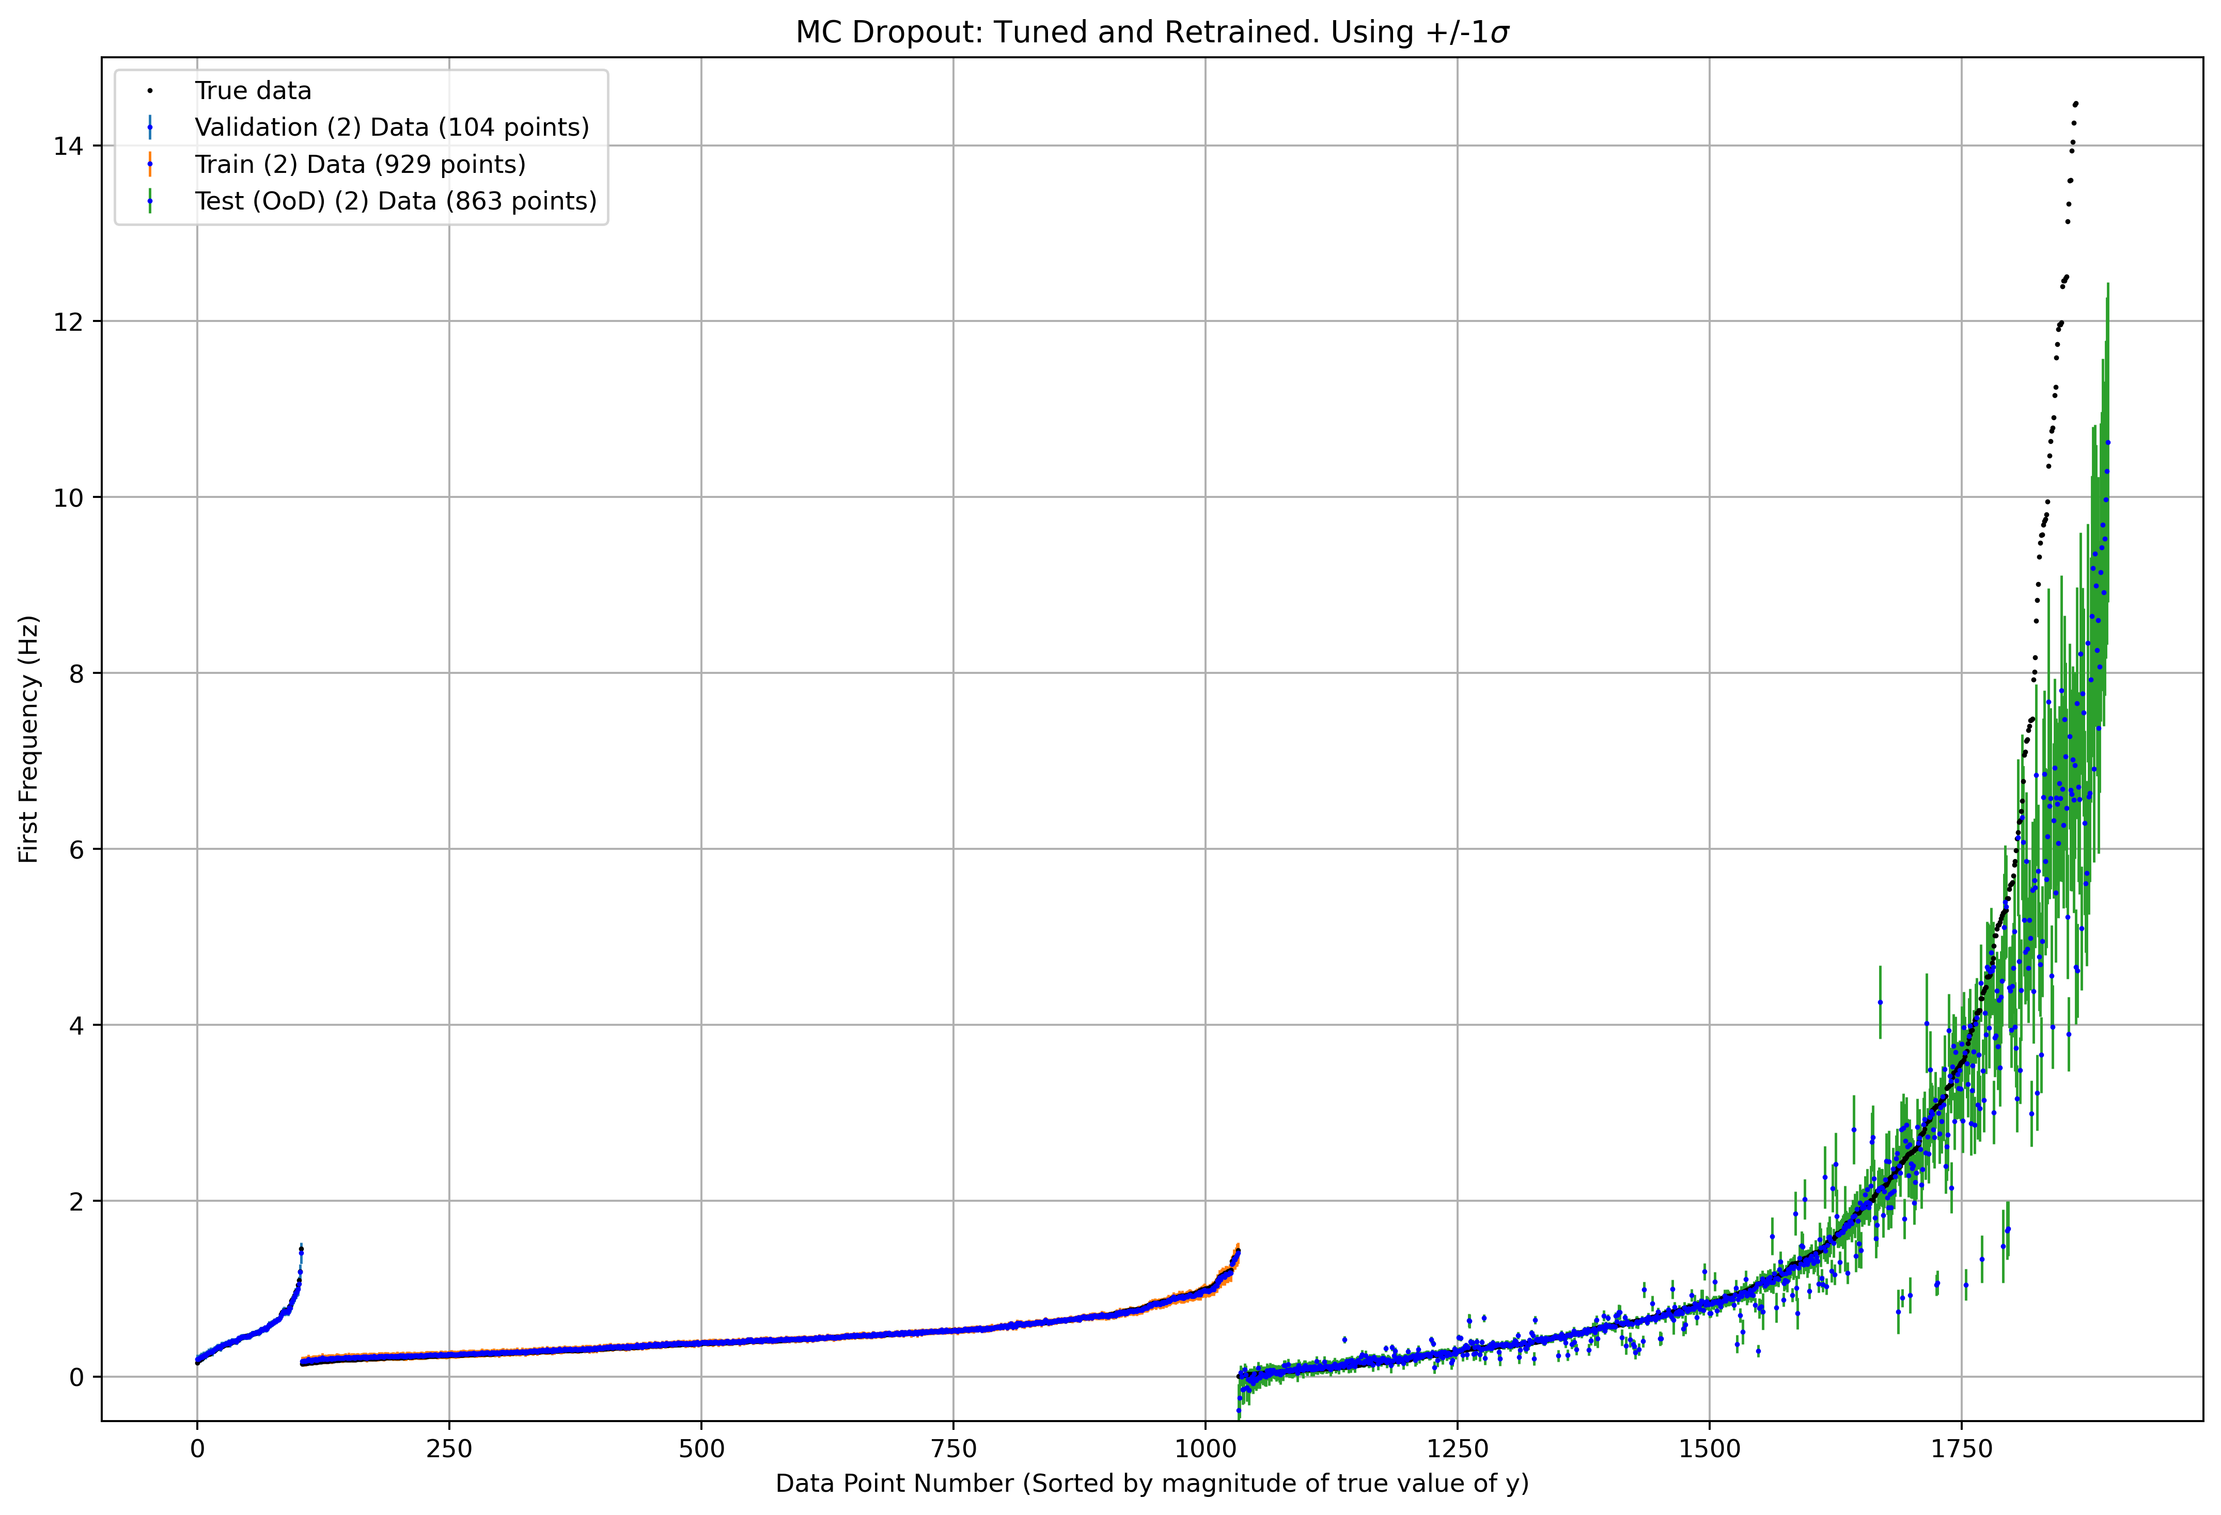
Results : Retraining with Additional Data

Slide 19
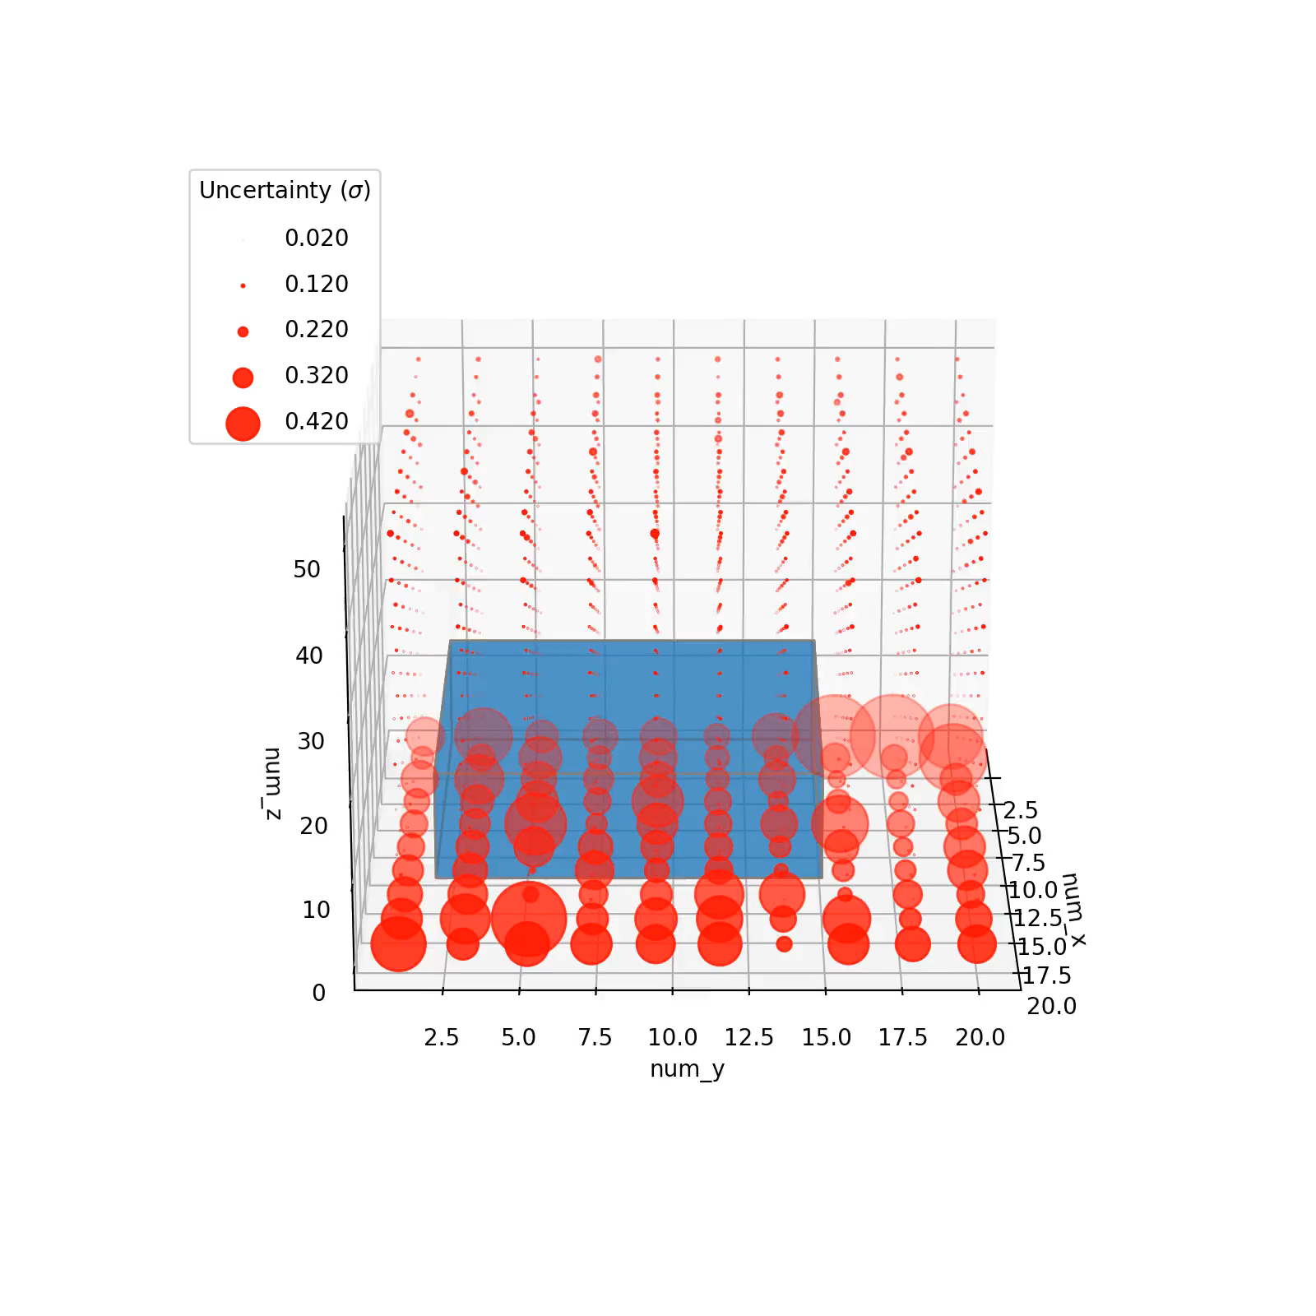
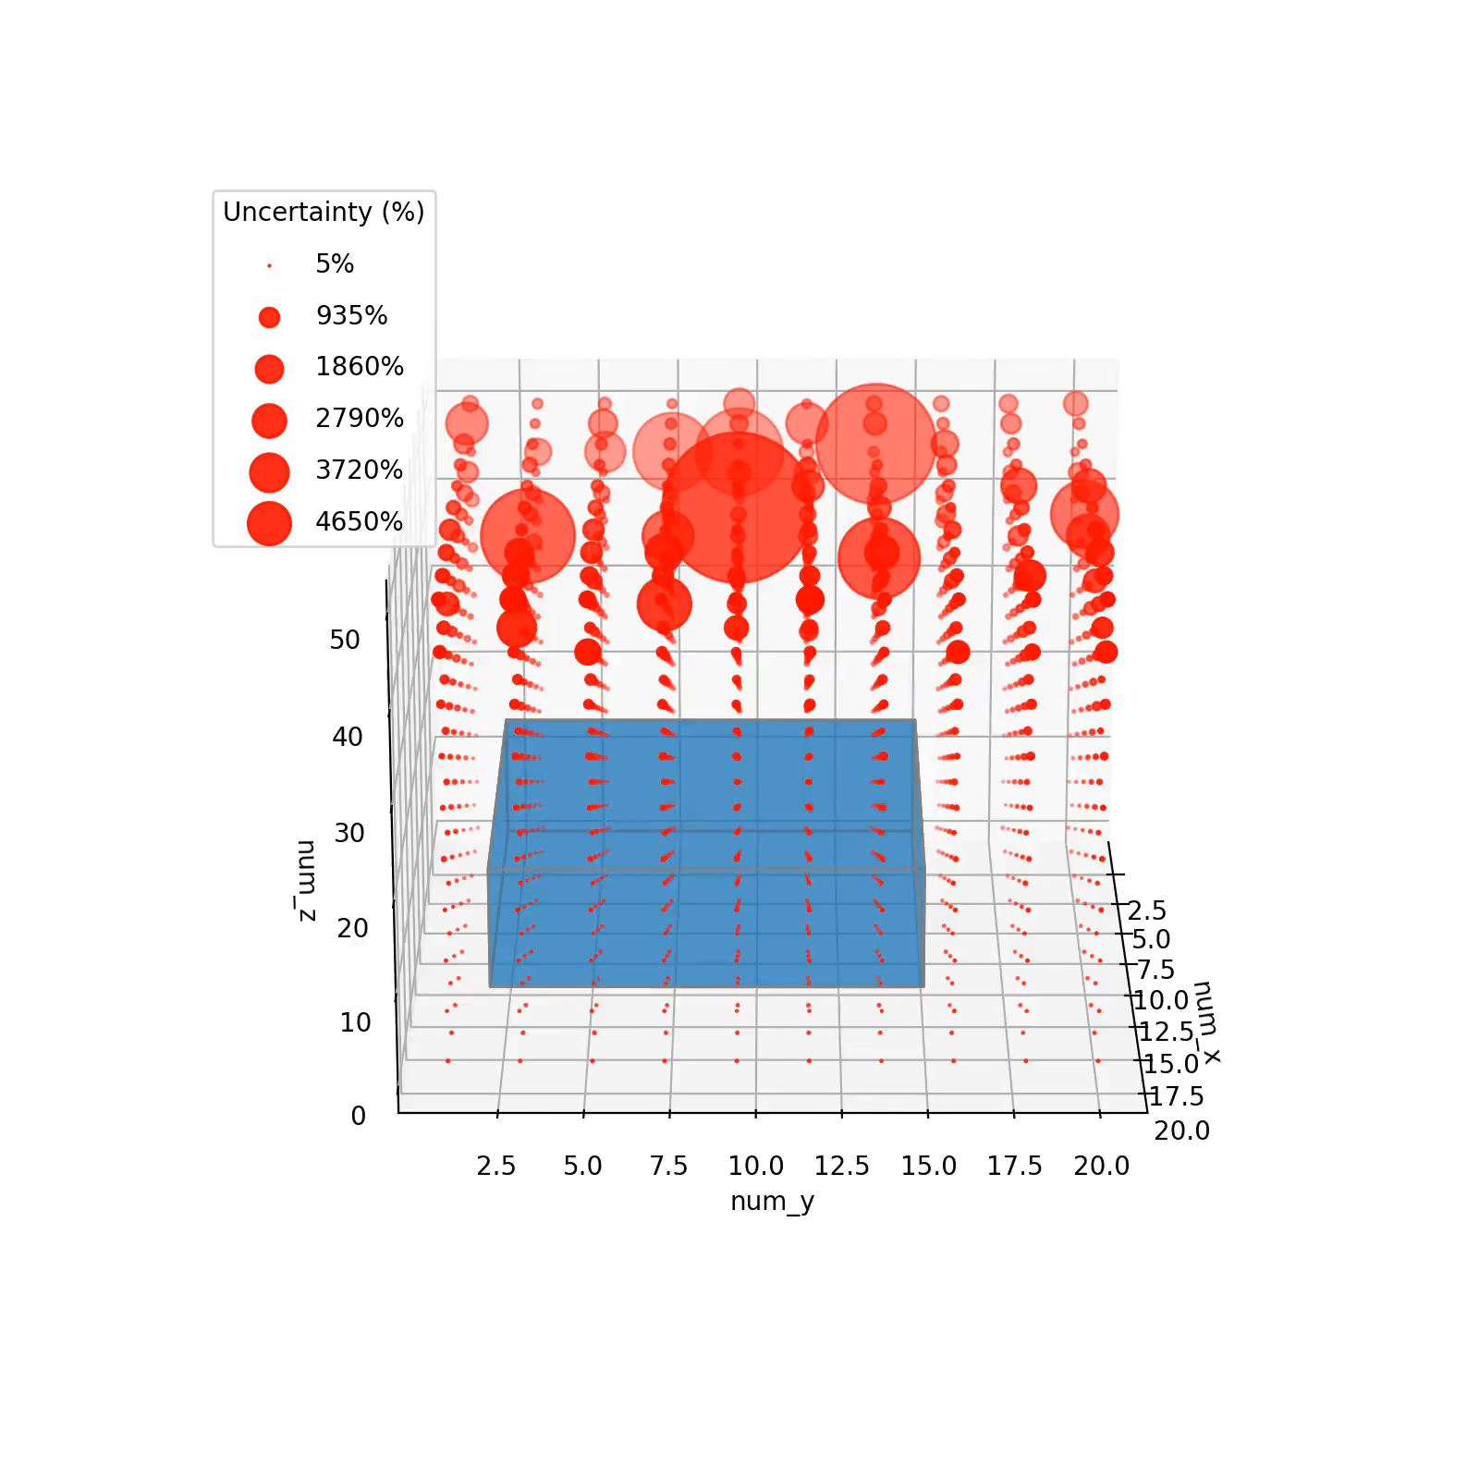
Results : Uncertainty - Unseen Geometries

Slide 20

Methodology Applying UQ to NNs - MC Dropout
num_x
num_y
num_z
dim_x
dim_y
dim_z
During training
Making prediction
Dropout as SRT

Slide 21
Methodology : MC Dropout
TRAINING
INFERENCE
num_x
num_x
num_y
num_y
num_z
num_z
dim_x
dim_x
dim_y
dim_y
dim_z
dim_z

